Slide 2
High Standards Philosophy
Notes:
Facilitator:
If this is the first-time participants are hearing about the Doc B Leadership Academy introduce the Academy. This is a great opportunity to build the “why” behind the “what” of leadership development based on the philosophies and values of Clovis Unified (script available in resource folder). If this is not the first time briefly review the purpose of the Leadership Academy.

Slide 3
Part II
Notes:
Facilitator:
The purpose of Part II is to go more deeply into the philosophies and values of our district. We examine how to apply the philosophy, generally using local resources and interviews of past and present leaders.

Slide 4
High Standards
“To be successful in developing and maintaining a school which meets the needs of all students, the principal must establish an atmosphere that is conducive to learning. Once they set school goals and high expectations for staff, it is imperative that they communicate them to the staff and to the community at large.”
Historical Overview, p. 25
Think about your messaging of school and/or department goals and expectations…
What determines the goals and expectations?
How do you know if you have achieved your goals and expectations?
What is your elevator message (30 seconds) about your goals and expectations?
Notes:
Script: Tiers I, II, III
Facilitator:
Read and discuss the quote from Dr. Buchanan. It can be found in the book Historical Overview of Clovis Unified School District, which was written by Dr. Buchanan in the late 1980’s. This quote is an excerpt from the section Role of Administration on pages 24-25 (available in resource folder if you choose to read). As you go through the Leadership Academy you will use this book as a resource.
In job alike groups of three discuss one or more of the following:
101 – What are the goals and expectations for you and your site/department? Be specific. How do you know when you have reached those goals and expectations?
Possible Answers: SART surveys, Climate assessment, Student surveys.
201 - What are the challenges in communicating, implementing, and maintaining high standards for your school and/or department?
301 – Every leader needs an elevator message. Something short that gets to the point that you can give consistently, over and over. Develop a 30 second elevator message that explains the goals and expectations for your department/school site. Don’t forget to include the “why” behind the “what”. Practice giving your 30 second elevator speech to member of your triad. Ask for feedback.
Ask for volunteers to share their elevator message.

Slide 5
When something is broken, fix it fast, fix it well, and fix it right
The philosophy that fuels the maintenance of facilities within Clovis Unified School District is simple, yet profound in its implication: when something is broken, fix it fast, fix it well, and fix it right! Historical Overview, p. 40
Notes:
Script: Tier I, II, III
Facilitator:
In the book Historical Overview of Clovis Unified School District Doc explains, “The philosophy that fuels the maintenance of facilities within Clovis Unified School District is simple, yet profound in its implication: when something is broken, fix it fast, fix it well, and fix it right!” To understand this value, we are going to read pages 40-43 titled Maintenance of Facilities.
Ask participants to organize themselves into small job alike groups. After reading the excerpt discuss one or more of the following questions (facilitator’s choice).
101 – Thinking about your department/school explain how you see this value in action. Provide examples.
201 - As a leader in your school/department what is your responsibility for making sure that things are fixed and well maintained? Provide specific examples.
301 – This value generally applies to our buildings and facilities, but we are going to put a little spin on it. Think about something that is broken at the district level. Once your group agrees on what is broken, discuss the following:
Can it be fixed quickly, if not what can we implement immediately?
How will we know if it is fixed well and right?
Ask each group to share their responses with the larger group.

Slide 6
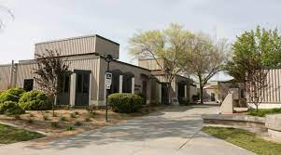
Build and maintain first class facilities. First Comprehensive Continuation School in California
Gateway/Enterprise High School CA PBIS Coalition Award - Silver 2021 CA PBIS Coalition Award - Silver 2019 Model Continuation High School 2018 National Drug Free School 1995 Clovis Community Day School CA PBIS Coalition Award - Silver 2021 CA PBIS Coalition Award - Silver 2019
Notes:
Script: Tiers I, II, III
Facilitator:
Steve Weil, former Assistant Superintendent, talks about high standards in all areas. When he was interviewed for the Leadership Academy, he shared a great story about building first class facilities. It goes something like this…when “CUSD proposed building a new continuation school campus right next to the District Office in 1973/74 and there was a lot of concern about “those students” and them not needing a brand-new campus, because they would mess it up.” Doc responded with “those kids as much as anybody deserve first-class facilities.” So CUSD built the first continuation school in California designed specifically for alternative education students. Gateway has been recognized on the national level as a school of excellence.
In the video we are about to watch Dr. Bradley and our teachers do a great job of explaining our value build and maintain first class facilities. No need for a graphic organizer but jot down a few notes about how you feel and what you are thinking while you watch the video. (Play Video on next slide)
Discussion Points:
In small groups respond to one or more of the following prompts (facilitators choice)
101 – What message did the district send with the building of Gateway?
201 – What is something you have done in your school or department that sends the same message?
301 – Please share the thoughts and feelings you had while watching the video. As a group choose three words to describe commonalities amongst the participants in your group.
As groups finish their discussions ask for volunteers to share their responses.

Slide 8
Students learn best when they are proud of their schools.
Notes:
Script: Tier I, II, III
Facilitator:
One our foundational values is the belief that students learn best when they are proud of their schools. There are many mechanisms in place that provide students with reasons to be proud of their school. One such mechanism are the California Distinguished School and Blue-Ribbon School programs. Dr. Fugman was principal of Kastner Intermediate when it was recognized as the first Blue Ribbon School in our District. He believed these types of recognitions are important to both the community and the kids. As leaders we are proud when our schools and departments are recognized for their efforts. Each recognition reminds the community that they are part of a successful organization.
Facilitators may choose to insert pictures of your school/department that embodies a celebration of a school-wide/department accomplishment.
Discussion Points:
In small groups respond to one or more of the following prompts (facilitators choice).
101 – Think about a time when you were able to celebrate an achievement in your school and/or department. What did you see/hear about the celebration from your parents/students/employees? Use specific examples.
201 – How much time did it take to plan the event? Was it worth the effort? Why or why not? In hindsight, could it have been done better? How?
301 – As a district is it important for us to continue to recognize the efforts made by schools and departments? What are the mechanisms used to celebrate our students and employees? Explain the purpose they serve and if they need to be revised.
As small groups finish ask them to share with the larger group.

Slide 9
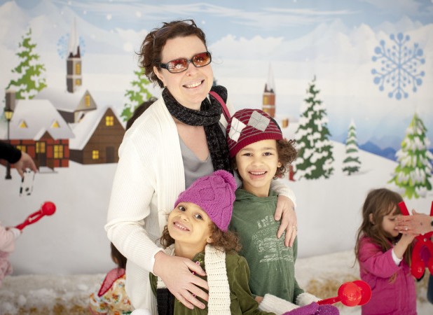
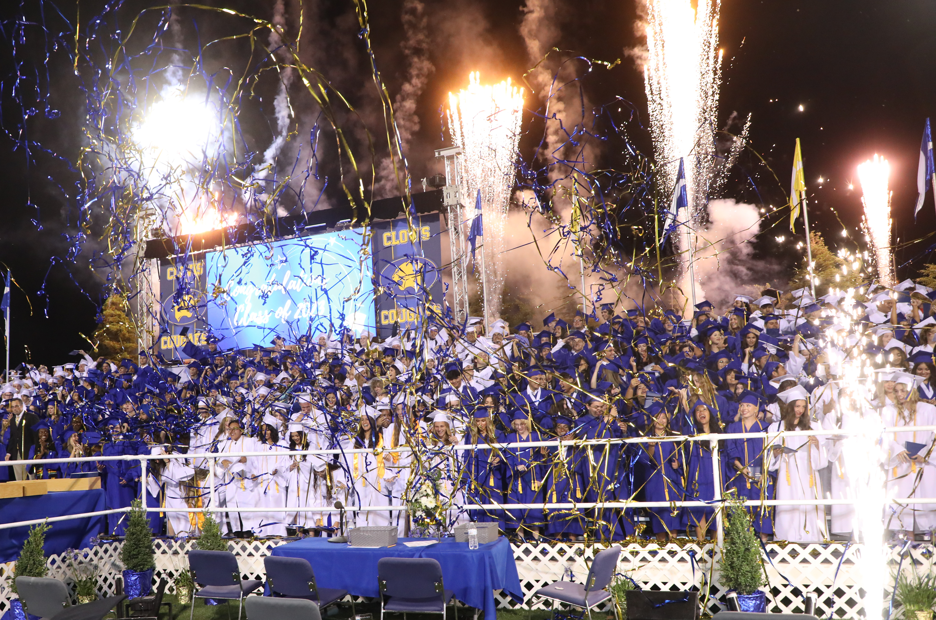
If we are going to do it, we are going to do it first class.
“Drive for show and putt for dough.” Doc, Rene, and Bobby
In your job alike group discuss a public event you feel did not meet the standards our community has come to expect. What was the “fall out” and what did you learn from the experience?
Notes:
Script: Tier I, II, III
Facilitator:
This quote has been attributed to both Doc, who lived at Belmont golf course, and Rene Errotabere, who was an avid golfer and administrator in our district. We did a little research, and, on the internet, it is attributed to Bobby Locke. In case you are like me and had no idea… he is generally regarded as one of the greatest golfers of all time. Not to take anything away from Doc or Rene : ) Ask participants to turn to a neighbor and discuss what the quote means in relationship to our value if we are going to do something we are going to do it first class. Ask for volunteers to share their thoughts.
For the next activity ask participants to form small job alike groups to discuss one or more of the following (facilitator’s choice).
Discussion Points:
101 – Thinking about your school/department what are the things you do for “show” and what do you do for the “dough”? Be specific and provide examples.
201 – As an individual please share a public event that did not meet the standards our community expects. Share what happened and what you learned. Choose one to share with the large group.
301 – What mechanisms do we have in place, as a district, that tells us if we are living up to our communities' expectations?
As groups finish ask them to share key learnings from their discussions.

Slide 10
We are too poor to buy cheap.
“The philosophy of finance in this district is very simple: a budget must be a financial statement of educational programs; in most large districts the educational program is a statement of budget. That doesn’t sound like much, but it is a whole different world. Floyd B. Buchanan, Ed.D.
Notes:
Script: Tier I, II, III
Facilitator:
One of the foundational values in our district is we are too poor to buy cheap. I use that one with my spouse, all the time : ) We are going to take some time to read about the effective use of funds. Pages 47-54 of the Historical Overview of Clovis Unified explains the history of funding in our district during the time Dr. Buchanan was Superintendent. Things have changed over the years, but it is always good to know the “why” behind the “what” of our District. You have a graphic organizer to support your note taking (available in resource folder). You may choose to work in a small group to jigsaw the excerpt.
Discussion Points:
In small groups (if the business department is present, include one member in each group) respond to one or more of the following prompts (facilitators choice)
101 – Notice the words in bold on the screen. What does this mean in our district? Explain your answer using examples.
201 – Examine the funding mechanisms in place during the 80’s. Which of these still exist and continue to benefit our district? Explain how the funding source benefits both schools and departments.
301 – Choose of the funding sources to examine how it is different today? Is it still beneficial? Explain your thinking with examples.

